Slide 1

UBER DATA ANALYSIS

Slide 2
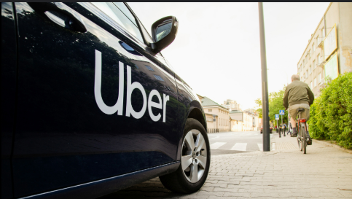
ABOUT THE ANALYSIS:
Uber is a multi national company that provides transportation services worldwide with a net revenue of $37.2 billion in 2023.
It is currently facing problems like:
ETA Estimation
Dynamic Pricing
Route Optimisation
Fraud Detection

Slide 3
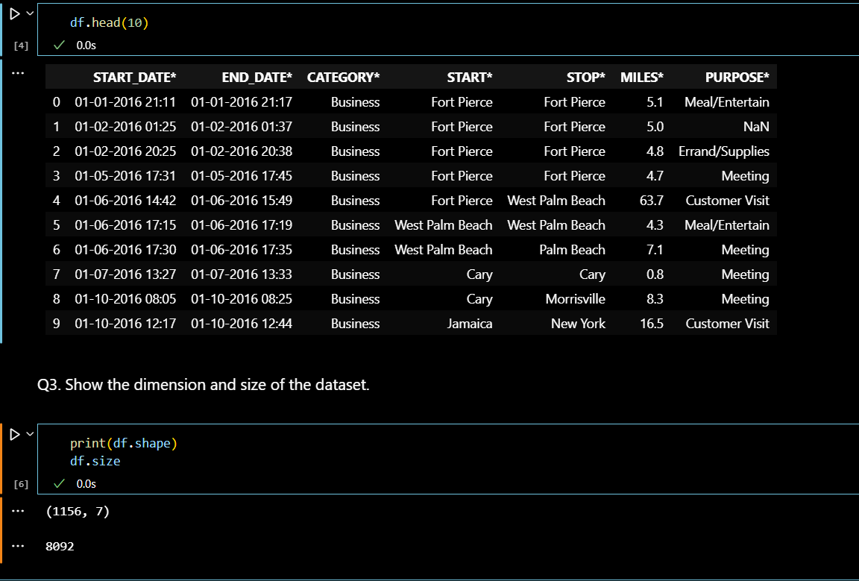
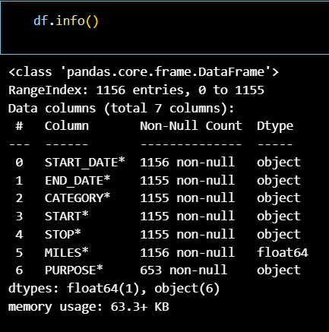
About The Data:-
The Data consists of start date and end date of the journey, category of Uber Rides, start and stop locations of the Rides, Miles are the distance covered of the Ride and Purpose of the Ride.
The Dataset have 1156 rows and seven columns. The information of all variables in Dataset:

Slide 4
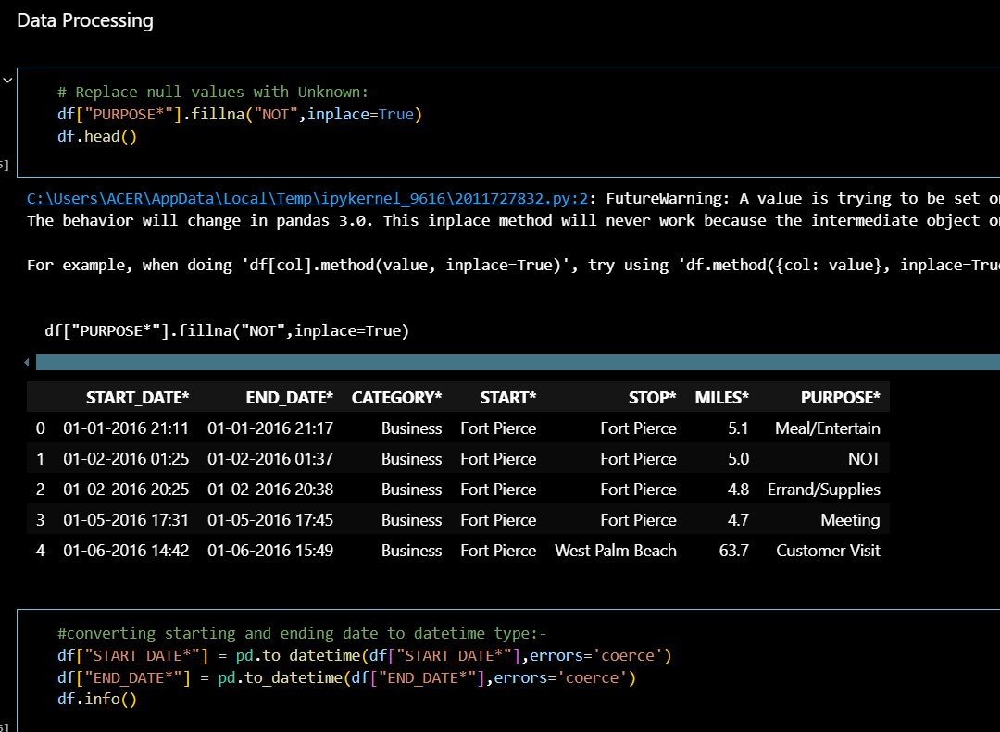
DATA CLEANING:-
We have removed unknown values in “PURPOSE*” Column with NOT.
The Datatypes of starting and Ending Dates are changed.
A new column in introduced to define at what time Ubers are mostly booked .
All the null values ie. Undefined information is dropped.

Slide 5
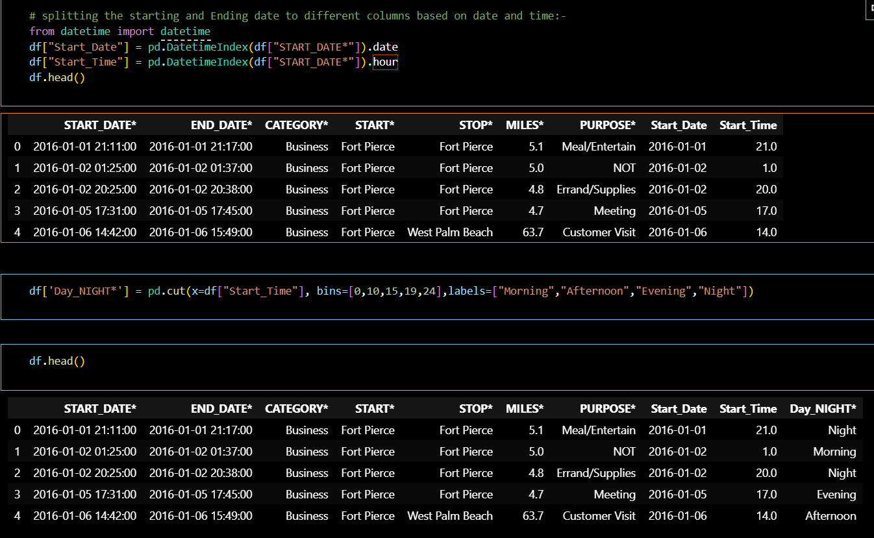
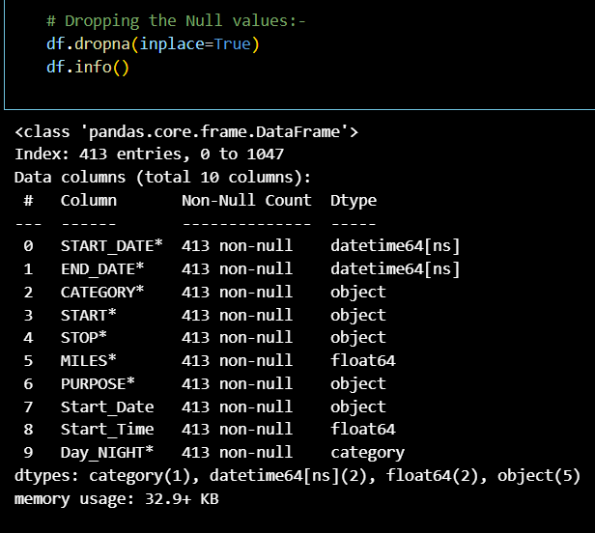

Slide 6
DATA VISUALIZATION:-
What was the Most frequent route taken by Uber Riders?
For which purpose was Uber Rides booked the most, based on Miles travelled?
For which category Uber Rides were booked the most?
At what time people book cab the most?
In which month people book Uber rides more and less frequently?
On which days of the weeks uber rides were booked the most?
For how many miles people usually books Uber for?
We answered all these Questions through Data Visualization→

Slide 7
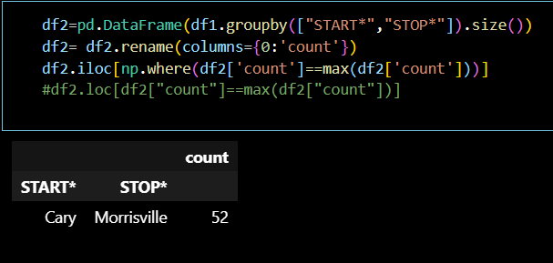
What was the Most frequent route taken by Uber Riders?

Slide 8
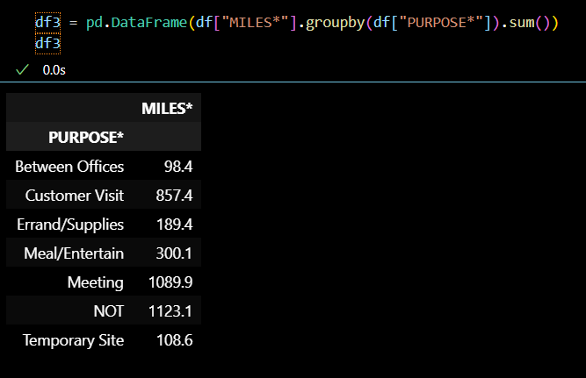
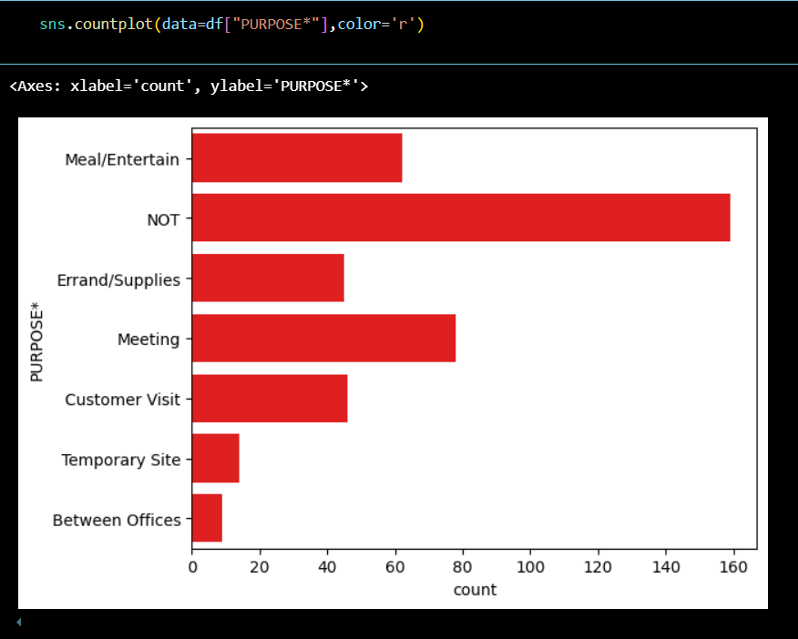
For which purpose was Uber Rides booked the most, based on Miles travelled?
For meetings ,Ubers are booked the most

Slide 9
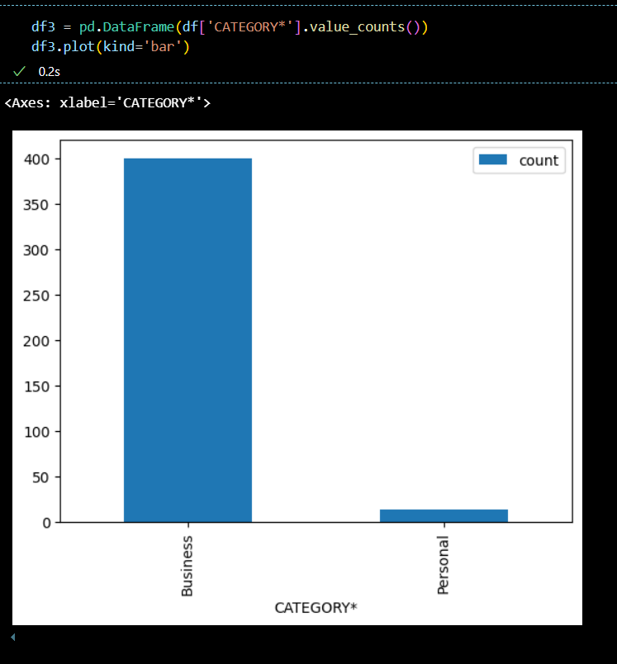
For which category Uber Rides were booked the most?

Slide 10
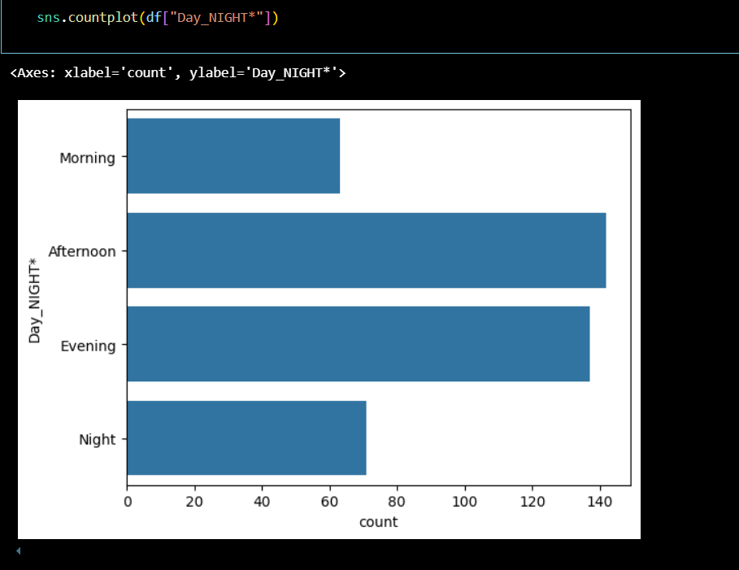
At what time people book cab the most?
In Afternoon and Evening Uber rides are booked the most followed by Night and then Morning.

Slide 11
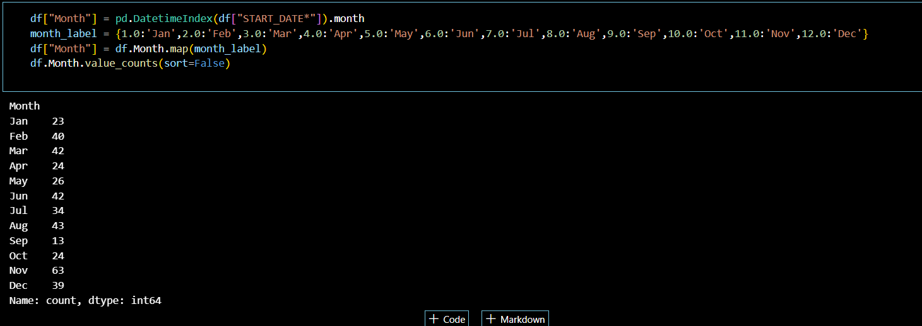
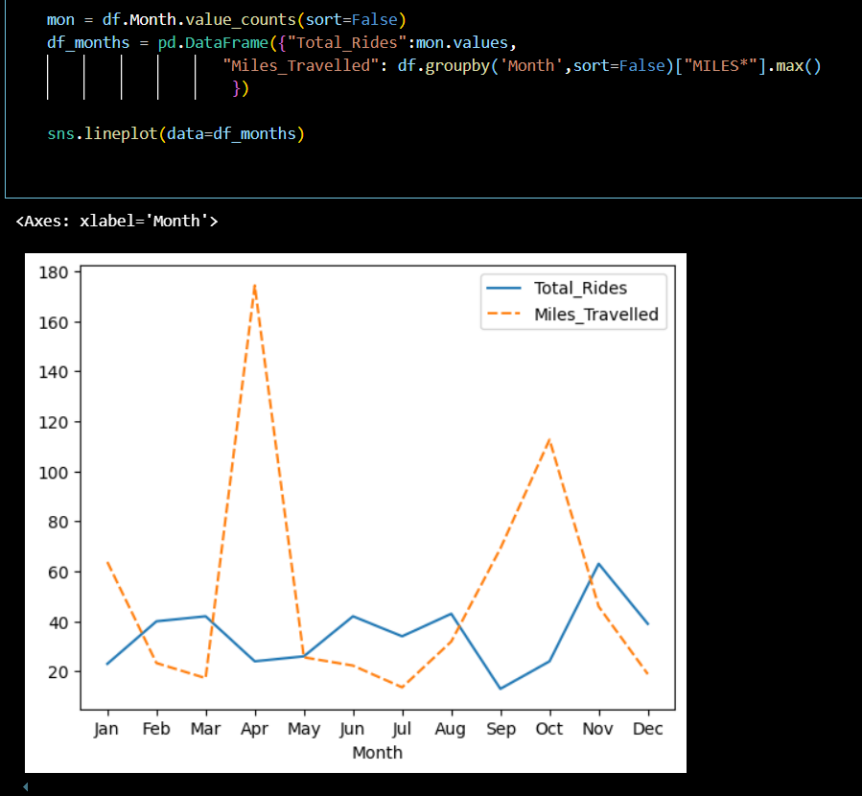
In which month people book Uber rides more and less frequently?
Procedure Followed for retrieving the insights

Slide 12
Most of the Rides were booked in the month of November and least rides were booked during September. In April , Most distant places were travelled and in December ,people booked Uber to even travel less miles.

Slide 13
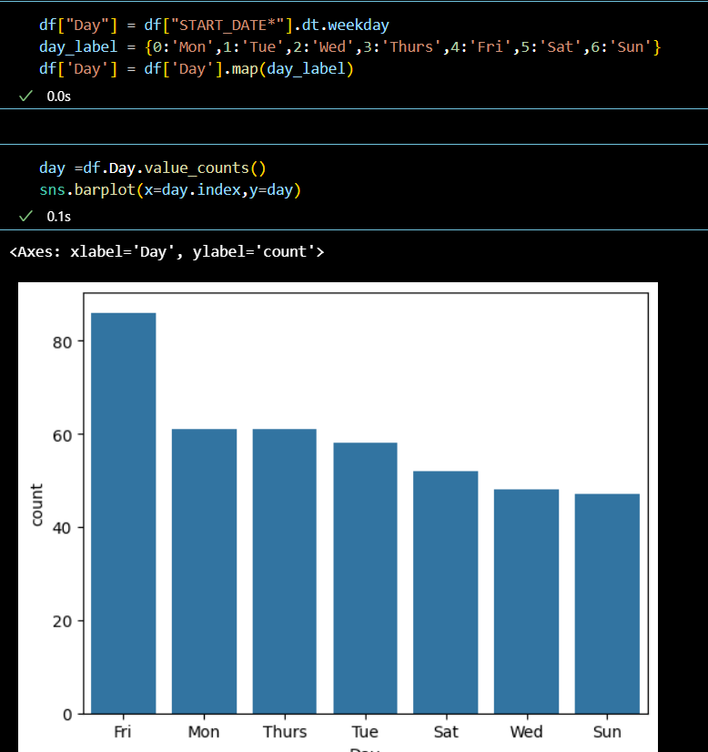
On which days of the weeks uber rides were booked the most?
On Friday, Uber Rides are booked the most and least Rides are booked on Sunday.

Slide 14
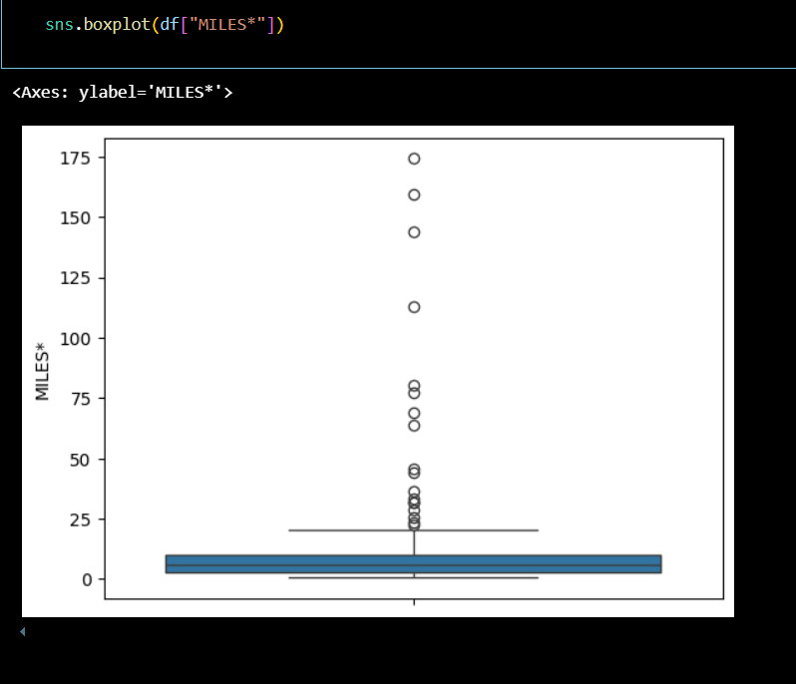
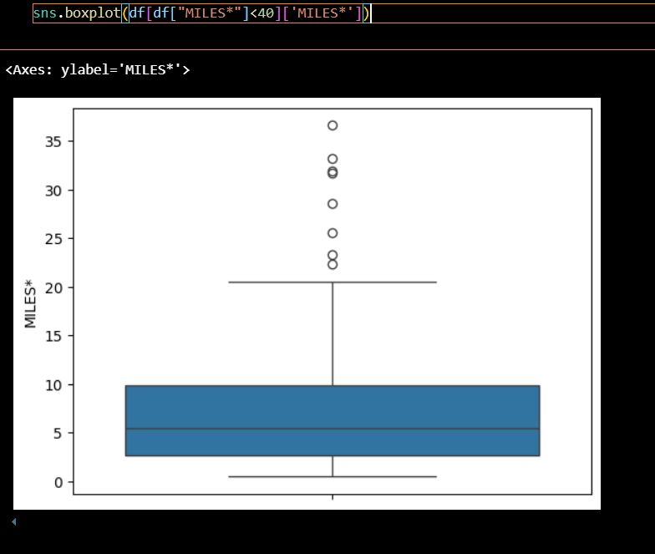
For how many miles people usually books Uber for?

